Slide 1
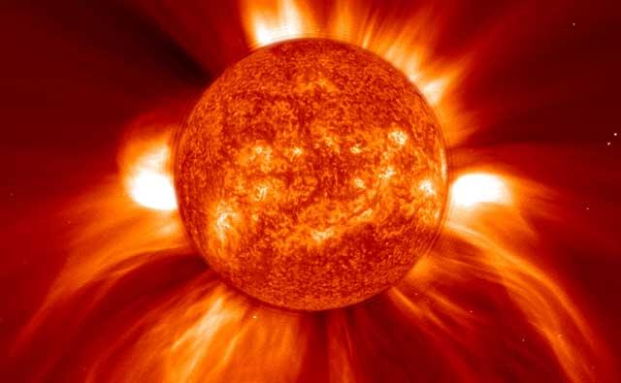
Stellar Winds and Mass Loss in the Late Stages of Stellar Evolution
Nicholas M. Hunt-Walker
General Exam – Feb 2015

Slide 2
Progression
Basic Definitions
Stellar Evolution
Stellar Winds and Mass Loss
The Point(s) of it All
Relation to My Work
Acknowledgments
Notes:
Start with the definitions of some basic concepts
Move on to the phases of stellar evolution that bring us to our late stages
Talk about the stellar winds and mass loss occurring at the ends of these star’s lives
Connect some of how how these winds relate to the rest of existence
Connect it to my work
Acknowledge people who helped

Slide 3
Basic Definitions
Stellar wind – the stream of particles (atoms/ions/molecules) emitted from a star
Stellar evolution – path of major phases during star’s atom-fusing lifetime
Atomic absorption – the absorption of energy from light by an atom with electrons
Atomic emission – energy emitted in the form of light by an atom
Ionization – the stripping of electrons from an atom
Beta decay (e⁺) – the conversion of a neutron into a proton by the emission of a positron (e⁺)
Notes:
Stellar wind – stream of particles
Stellar evolution – phases of atom-fusing life
Atomic absorption – absorption of light energy by an atom with electrons
Atomic emission – emission of energy in the form of light
Note with ionization that in the centers of stars, you are guaranteed to have an ionized gas as temperatures are at millions of degrees K
Beta decay aka positron emission – the conversion of a neutron into a proton in the nucleus of an atom, results in the emission of a positively-charged electron. Occurs in unstable atomic nuclei

Slide 4

Basic Definitions
The Electromagnetic Spectrum – the range of wavelengths/energies of light
Credit: http://commons.wikimedia.org/wiki/File:EM_spectrum.svg
Notes:
Range of wavelengths and energies of light

Slide 5
Stellar Evolution
The Main Sequence
Low/Intermediate Mass Stars (0.8-2 M⊙, 2-10 M⊙)
High Mass Stars ( > 10 M⊙)
Notes:
Dipping into Stellar Evolution
Start with the main sequence, then split into mass regimes.

Slide 6
The Main Sequence*
Main Sequence
Increasing Luminosity (Brightness)
Increasing Temperature (Kelvin)
*Re-enactment
Notes:
The approximate temperature—luminosity diagram for stars. Luminosity increases going up. Temperature increases going to the left. I’ve placed a sun icon at about where the Sun is on the main sequence of stars; where most stars live.

Slide 7
The Main Sequence
Characterized by the processing of hydrogen (H) into helium (He) via nuclear fusion
0.08 < M* < 120 M⊙
Limited by…
M* < 0.08 M⊙ cannot fuse H into He
M* > 120 M⊙ rare/cannot hold self together
Notes:
The main sequence characterized by H fusion

Slide 8
The Main Sequence
Two types of H-fusion (nucleosynthesis):
Proton-proton chain
Carbon-nitrogen-oxygen cycle
★Both produce ⁴He from 4 H’s★
Notes:
Before getting into fusion, note that you need two things to even have fusion: high temperatures AND high densities. High density and low temperature: particles aren’t energetic enough to overcome electrostatic repulsion. High temperature and low density: particles aren’t close enough to fuse.

Slide 9
The Main Sequence
Proton-proton Chain (simplified)
e⁺
Deuterium
γ
H
H
Helium - 3
N
H
H
H
N
Helium - 4
H
H
H
H
e⁺
N
N
H
H
H
N
H
H
H
N
H
γ
Notes:
Proton chain step by step:
Hydrogen
Deuterium + positron emission (energy)
Helium 3 (energy)
Helium 4

Slide 10
The Main Sequence
CNO Cycle (simplified)
γ
H
H
¹⁴N
γ
¹³C
¹⁵O
e⁺
e⁺
¹³N
¹⁵N
γ
¹²C
H
H
H
H
⁴He
N
N
Notes:
Stars need to at least have some carbon to start this
Carbon plus hydrogen = nitrogen plus energy
Nitrogen beta decays to carbon
Carbon plus hydrogen = stable nitrogen
Nitrogen plus hydrogen = oxygen plus energy
Oxygen beta decays to nitrogen
Nitrogen plus hydrogen = Carbon plus helium; cycle restart

Slide 11
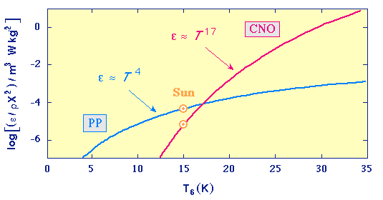
The Main Sequence
Core temperature T_{c} decides which dominates energy production
p-p chain: T_{c} < 17 x 10⁶ K
CNO cycle: T_{c} > 17 x 10⁶ K
Energy (E) output highly dependent on temperature
M < 1.25 M⊙; p-p chain; output scales as T_{c}⁴
M > 1.25 M⊙; CNO cycle; output scales as T_{c}¹⁷
Energy Output
Credit: http://csep10.phys.utk.edu/astr162/
Notes:
If you’re in the PP chain, increasing the central temperature by 10% increases the energy output by ~50%
In the CNO cycle, increasing central temperature by 10% increases energy output by 500%

Slide 12
The Main Sequence
Convection
Cold Exterior
E must be transported from source to surface
Radiation creates gradient in T (∂T/∂r) based on source output, gas density, and gas opacity κ
Hot, less dense blobs of fluid rise through cooler, denser surroundings
Occurs when E in blob of fluid so high that E lost to surroundings is low compared to remaining E in blob
R
Energy Source

Slide 13
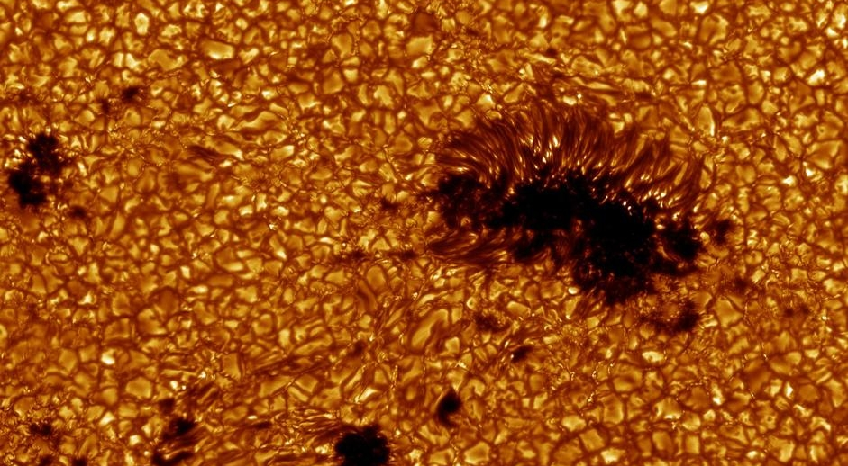
The Main Sequence
Convection Example: The Sun
Credit: http://www.sun.org/images/the-solar-surface

Slide 14
The Main Sequence
Holds shape through hydrostatic equilibrium
He accumulates in core from fusion
Convection occurs…somewhere depending on star’s mass
Effective surface temp T_{eff} set by energy generated in core
Luminosity L effectively★:
★actual luminosity also depends on chemical composition
Stellar
Envelope
F_{g}
Core
H He
Convection
*Not at all to scale
Notes:
Stars maintain their shapes with a balance between gravity pulling inward, and radiation pressure pushing outward
Regardless of the fusion process, helium accumulates in the core
Where convection occurs depends on the mass of the star
The apparent temperature of the surface (the temperature corresponding to the amount of radiation it’s putting out) is set by energy generated in the core
Luminosity is the brightness of the star, and that scales with the square of the star’s radius, and its effective temperature.

Slide 15
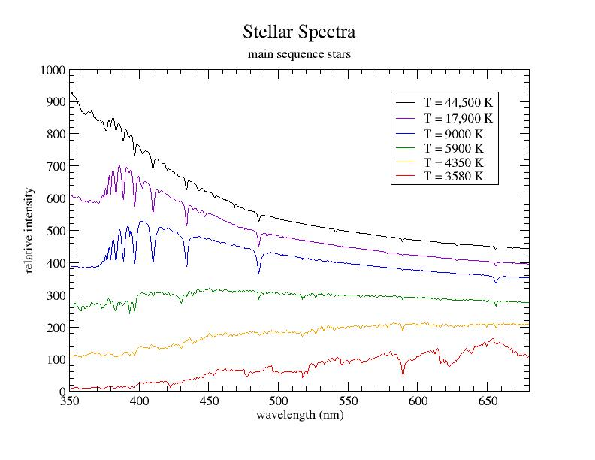
The Main Sequence
Observationally, spectral energy distribution characterized chiefly by T_{eff} and composition
Colored lines represent where peak intensity is and color of star* *Stars really appear red, yellow, white, or blue-white
Credit: http://homepages.wmich.edu/~kaldon/classes/ph106-2-link-salad.htm

Slide 16
Low/Intermediate-mass Star Evolution
Increasing Luminosity (Brightness)
Increasing Luminosity (Brightness)
Increasing Temperature (Kelvin)
Increasing Temperature (Kelvin)

Slide 17
Low/Intermediate-mass Star Evolution
Generally low* and intermediate-mass stars experience same phases; differences in timing, and interior
Basic phases:
subgiant branch (SbG)
red giant branch (RGB)
horizontal branch (HB)
asymptotic giant branch (AGB)

Slide 18
Low/Intermediate-mass Star Evolution: SbGs
Subgiants
Core fusion has ended
Radiative pressure = 0; gas pressure supports star
Core contracts rising in T; heats H shell around core; pressure from envelope increases density of H shell
When H shell around core hot enough, shell fusion begins; SbG phase ends
Increasing Luminosity (Brightness)
Increasing Luminosity (Brightness)
SbG
Increasing Temperature (Kelvin)
Increasing Temperature (Kelvin)

Slide 19
Low/Intermediate-mass Star Evolution: RGBs
Red Giants
Core fusion still off; H fuses in shell around inert He core
Convection reaches to just outside H shell; mixes materials to surface
Energy from H fusion puffs out envelope; 20 < R* < 100 R⊙
T_{eff} falls to between 3-4,000 K
Because of large size/despite low T_{eff}, L ~ 10² – 10³ L⊙
Toward RGB end, stars losing significant mass due to stellar winds and pulsation (later)
H to He in shell
Inert
He

Slide 20
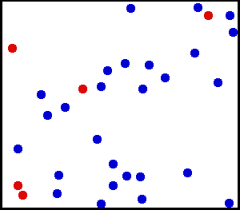
Low-mass Star Evolution: Degeneracy
Physical state where particles are all trying to have the same energy
Requires high densities and high pressures (e.g. gravity)
The more you try to compress, the higher the pressure
From Heisenberg Uncertainty Principle,
From definition of temperature:
Result: compression heats core
Loosely packed
and “filled”
All the spaces
are filled!
Credit: Wikipedia

Slide 21
Low-mass Star Evolution: RGBs
H shell fusion dumps He on inert core
Core He contracts to isothermal, electron-degenerate core; slows contraction
Degenerate He core heats up as slow contraction continues; envelope expands
When T_{c} reaches 10⁸K (~0.5 M⊙), He fusion ignites in flash; at tip of RGB
Tip RGB
RGB
Increasing Luminosity (Brightness)
Increasing Luminosity (Brightness)
Increasing Temperature (Kelvin)
Increasing Temperature (Kelvin)

Slide 22
Intermediate-mass Star Evolution: RGBs
H shell fusion dumps He on inert core
Core He contracts and heats as mass dumps on
Shell temp grows as core contracts; CNO cycle takes over and grows at huge rate do to T¹⁷ dependence
envelope expands as shell fusion intensifies
At T_{c} ~ 10⁸K, He quietly ignites in core
Tip RGB
RGB
Increasing Luminosity (Brightness)
Increasing Luminosity (Brightness)
Increasing Temperature (Kelvin)
Increasing Temperature (Kelvin)

Slide 23
Low/Intermediate-mass Star Evolution
Triple-α Fusion (simplified)
very
unstable
τ ~ 10⁻¹⁶ s
H
H
N
N
H
H
N
N
⁴He
⁸Be
¹²C
H
H
N
N
γ
γ

Slide 24
Low/Intermediate-mass Star Evolution: HBs
Horizontal Branch Stars
He fusion by Triple-α in core; core expands
Fusion in expanding core diminishes H shell fusion
Less-intense fusion reduces envelope size
T_{eff} varies widely with progression of fusion
Little if any convection
Weaker H shell fusion
Inert He Shell
⁴He to
¹²C

Slide 25
Low/Intermediate-mass Star Evolution: HBs
As core expands from fusion it cools; envelope contracts
Contracting envelope causes T_{eff} to rise, changing color of star; also dimmer
Higher initial M*, redder star (larger envelope)
As HB phase continues, core fuses He + C into O
At HB end, core is C-O mix and He-fusion pushed out into shell
HB
Increasing Luminosity (Brightness)
Increasing Luminosity (Brightness)
Increasing Temperature (Kelvin)
Increasing Temperature (Kelvin)

Slide 26
Low/Intermediate-mass Star Evolution: AGBs
Final stage of evolution
Begins with…
C+O core
weak He shell fusion
non-fusing He
H shell fusion
highly convective envelope
convection mixes He and N to surface
Envelope is physically larger than outermost shell by ~10⁴
He fusion feeds C+O core with products at low rate
H fusion feeds He shell more than it can fuse
H shell fusion
Inert He Shell
He shell fusion
C+O
Core
*Not the least bit to scale

Slide 27
Low/Intermediate-mass Star Evolution: AGBs
Thermal Pulses (TP)
When He gets enough material and is hot enough, He fusion grows exponentially (though brief)
Growth in He fusion shuts down H fusion
Loss of H fusion makes envelope contract in size (~15%); surface L drops (~50%)
Convection reaches deep into inert He shell, mixing contents (C, N, O, He, others) outward
He shell unstable; dies quickly (10² yrs) and H shell resumes fusing
Periodic ~ 10³⁻⁴ yrs
Travels up and down
from TPs
AGB
Increasing Luminosity (Brightness)
Increasing Luminosity (Brightness)
Increasing Temperature (Kelvin)
Increasing Temperature (Kelvin)

Slide 28
Low/Intermediate-mass Star Evolution: AGBs
More Nucleosynthesis: The α-process
γ
¹²C
H
¹⁶O
H
N
N
¹³C
H
¹⁶O
n
H
N
N
γ
¹⁴N
H
¹⁸F
H
N
N
²²Ne
H
²⁵Mg
n
H
N
γ
N
¹⁸O
H
²²Ne
H
N
N
Notes:
Alpha process elements:

Slide 29
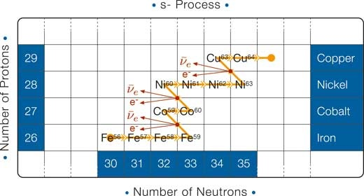
Low/Intermediate-mass Star Evolution: AGBs
More Nucleosynthesis:
Slow neutron capture
Starts with ⁵⁶Fe as seed
Neutrons from ¹⁶O and ²⁵Mg
Neutrons bombard nuclei until nuclei become unstable
Unstable nuclei β-decay (n⁰ becomes p⁺ and atom loses e⁻)
Creates heavy elements up through Yttrium (39 p⁺)
Occurs during TP-AGB in He shell
Credit: http://www.scienceinschool.org/repository/images/issue5fusion5_large.jpg

Slide 30
Low/Intermediate-mass Star Evolution: AGBs
Short-Term Pulsation
Partially-ionized He (He⁺) captures outgoing radiation
Instead of puffing atmosphere, heat ionizes He; star contracts
Ionization completes; star expands (~50%)
Big atmosphere = cooler atmosphere = He recombination
He recombination captures energy again; cycle resumes
Periodic ~1-3 yrs
He⁺ ions become He⁺⁺
1
Less outgoing radiation
2
Radiation flows freely
He layer cools
3
He⁺ ions
recombine

Slide 31
Low/Intermediate-mass Star Evolution: Recap
Stars with 0.8 < M* < 10 M⊙ run through similar phases:
subgiant branch (SbG)
red giant branch (RGB)
horizontal branch (HB)
asymptotic giant branch (AGB); end as a star
Each phase has differences in fusion location and type
Elements forged in dynamic star interiors
AGBs pulsate on short terms (~1 yr) and long terms (10³ yrs)
More on post-AGB life later…

Slide 32
High-mass Star Evolution
Increasing Luminosity (Brightness)
Increasing Temperature (Kelvin)

Slide 33
High-mass Star Evolution
MS energy generated chiefly by CNO cycle
L ~ M*³; Extremely bright
10 M⊙ ≈ 10³ L⊙
25 M⊙ ≈ 10⁴ L⊙
High-mass < 50 M⊙; very high-mass > 50 M⊙
Convection deep in interior; can be entire star if hot enough
CNO
cycle

Slide 34
High-mass Star Evolution: SG
He builds up in core
He core contracts and heats
H fusion continues in shell
H shell puffs up star; L* doesn’t change (much)
Larger envelope + same energy output = cooler brighter star (supergiant!)
SG
Increasing Luminosity (Brightness)
Increasing Luminosity (Brightness)
Increasing Temperature (Kelvin)
Increasing Temperature (Kelvin)

Slide 35
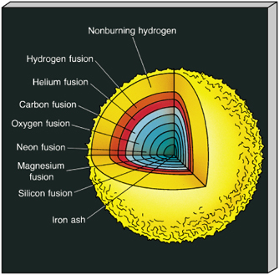
High-mass Star Evolution: Layers
Depending on mass, star travels back and forth along supergiant path several times
When enough material for next fusion phase is present, it begins in core
Previous fusion continues in shells
Credit: http://www.castlerock.wednet.edu/HS/stello/Astronomy/TEXT/CHAISSON/BG312/HTML/BG31204.htm

Slide 36
High-mass Star Evolution: α-process
Higher T_{c}, densities, and a wider assortment of elements allows larger range for α-process than before
Occurs during/after ²⁸Si fusion
All takes about a day
In addition to previously… (add He each step)
²⁸Si
³²S
³⁶Ar
⁴⁰Ca
⁴⁴Ti
⁴⁸Cr
⁵²Fe

Slide 37
High-mass Star Evolution: WR stars
Brief stage of life before SN explosion for M* > 25 M⊙
Three types:
WN: strong N emission
WC: strong C emission; H-shell gone
WO: strong O emission; H-shell gone
Can evolve from BSGs, RSGs, or LBVs
Fusion still occurring feverishly in core & shells
So hot the emit mostly in UV and X-ray
Very few observed (~500 in Milky Way)
Notes:
Explain briefly what an LBV is and how stars become LBVs during He shell fusion

Slide 38
Stellar Evolution Summary
Low/Intermediate mass stars become AGB stars
Forge many light-medium elements by H & He fusion, α-process, and slow n⁰ capture
High mass stars evolve become RSG, BSG, and WR stars
Massive stars forge light elements through to heavy elements by fusion, and α-process
Only part of the story…

Slide 39
Stellar Winds and Mass Loss
Line-driven Winds from hot, high-mass stars
Dust-driven winds from cool stars

Slide 40
Doppler Shift
Appears
v = 0
source
observer
λ₀
λ₀
v = toward (-)
v
blueshift
λ_{b}
λ₀
Δλ
v = away (+)
v
redshift
λ₀
λ_{r}
Δλ

Slide 41
Line-driven Winds
Gas moved by radiation pressure from photon absorption
Photon absorption transfers momentum from photon to particle
Collisions in gas move gas outward
The faster particles move, the more light they can absorb, and the faster they’ll go
1 very strong absorber (absorbs/scatters all light at λ₀)…
Due to Doppler shift of atom moving at velocity v, can absorb photons between
and
λ₀
C
Energy absorbed per sec by these atoms:
Photon momentum:
Momentum transferred to gas per sec:
Momentum of gas per sec:
Mass loss rate:
If absorbed line at peak of star emission:
Finally, mass loss rate:

Slide 42
Line-driven Winds
•
M ≈ 0.6L*/c² per heavy-absorbing line
If…
M* = 15 M⊙ & L* ≈ 10⁴ L⊙, M ≈ 4 x 10⁻¹⁰ M⊙ yr⁻¹ and 4 x 10⁻³ M⊙ lost on MS (i.e. 4 Jupiters)
M* = 25 M⊙ & L* ≈ 10⁵ L⊙, M ≈ 3 x 10⁻⁹ M⊙ yr⁻¹ and 10⁻² M⊙ lost during MS
Typically have 10²⁻³ strong spectral lines in hot stars
M* = 15 M⊙ then loses ~2.6 – 26% of mass during MS
M* = 25 M⊙ loses ~4 – 40% of mass on MS
Abbott 1982
•
•

Slide 43
Line-driven Winds
v
Blue-shifted emission
Mass loss envelope
λ₀
Blue-shifted absorption
v
Line of sight
λ₀
λ₀
Observer
Red-shifted emission
v
photon wavelength λ₀
λ₀
Regular emission
From star
P Cygni profile!
Intensity
Intensity
Wavelength
Wavelength

Slide 44
Line-driven Winds
Radiation pressure drives winds to 1-4,000 km/sec (~1% light speed)
Metal enrichment of stellar atmosphere increases wind efficiency (more Fe, better wind)
In half the lifetime of 25 M⊙ star with 10³ km/sec wind, gas from fills space 5 x 10³ ly in radius
Kudritzki & Puls 2000
WR 124; Mujires 2010

Slide 45
Line-driven Winds: Surface Chemistry
Winds of hot stars rapidly carry away outermost layers of stars
Change surface abundance as mass diminishes
⁴He
¹H
Surface Abundance
¹²C
Remaining Mass
Chiosi & Maeder 1986

Slide 46
Line-driven Winds Summary
Gas in star’s outer atmosphere driven by the transfer of momentum from radiation
Momentum transfers through atomic absorption
Absorbing atoms drag surrounding gas through particle-particle interactions
Bulk movement of gas causes larger mass loss in hotter, more massive stars
Gas moves really far; enriches surrounding ISM

Slide 47
Dust-driven Winds: Dust
“Dust” refers to grains with size < 0.1µm
Grain size limited by collisions with gas
From mixing due to deep convection in TPs, outer layers enriched in C/O
CO molecules readily form; excess of C or O in atmosphere defines chemical type of dust
Oxide/carbon dust amount depends heavily on star metallicity and TPs
Occurs heavily in AGB stars and RSGs
Notes:
Dust formed is either heavily C or heavily O depending on the abundance of either. If more C than O, then majority of O is locked up in CO

Slide 48
Dust-driven Winds: Dust
Examples
Chemically-bound conglomerates
of molecules
Al
O
O
Acetylene (C₂H₂)
Al
Aluminum Oxide (Al₂O₃)
O
O
O
Anthracene (C₁₄H₁₀);
a polycyclic aromatic
Hydrocarbon (PAH)
Si
Silica (SiO₂)
Polyaromatic hydrocarbons (PAHs); Draine 2003

Slide 49
Dust-driven Winds
Like gas in line-driven winds, dust grains can also be driven by photon absorption
Absorption not just from specific lines
Radiation pressure must > gravity
However…
Opacity of dust: κ_{d} ≈ 10 cm² / g (carbon)
5 cm² / g (oxide)
Radiation Pressure force:
Force of Gravity:
For oxide dust:
For carbon dust:
Typical M_{AGB}: 1-9 M⊙
Typical L_{AGB}: > 10³ L⊙
10³ >>>>> 150 or 300
✔

Slide 50
Dust-driven Winds
Radiation can only drive dust if dust has formed
At star surface, T_{eff} ≈ 3000 K
Oxide/carbon dust sublimates at 1200-1500 K
Dust can’t form at surface!
Energy absorbed by dust grain per second:
Energy emitted by dust grain per second:
And so…

Slide 51
Dust-driven Winds:
Enter Pulsations
Recall: because of an opaque layer in AGB atmospheres, they pulsate
Pulsation tosses outer layers up beyond R*
Successive pulsations leaves outer layers with a small outward velocity
At about 2R*, dust can form
Once dust forms, enter radiation pressure

Slide 52
Dust-driven Winds:
Differences with RSGs
RSGs show significant dusty stellar winds, but show weak variability! Also generally hotter than AGBs
Large-scale convection in RSGs create supersonic surface turbulence (Josselin & Plez 2007)
Surface turbulence and radiation pressure drive molecules to large distances from the star
At large distances, molecules condense to dust grains and move outward from radiation pressure
Work is ongoing in quantifying the effect (Puls et al 2015)
Simulated RSG; Chiavassa & Freitag 2014

Slide 53
Dust-driven Winds: Observability
Warm O-rich (SiO, AlO) and C-rich (SiC, PAH’s) dust emit in the mid-IR
Easily detectable to distances of nearby galaxies (Ishihara et al 2011; Boyer et al 2013)
C-rich and O-rich AGB star emission in
the IR (Ishihara et al 2011)

Slide 54
Dust-driven Winds: Observability
Abundant CO in dust shell around all AGB stars can be seen distinctly in radio
CO undergoes low-energy transitions from collisions with H₂ and excitation from IR light
Breadth of CO line gives estimate of wind speed
Radio Intensity
Wind Speed (km/s)
Ramstedt & Olofsson 2014

Slide 55
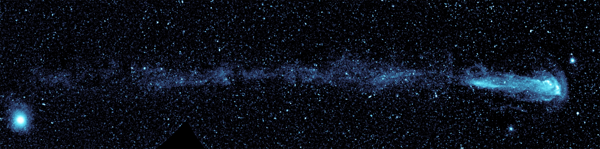
Dust-driven Winds: Last Bits
The AGB star Mira, courtesy of GALEX
Dust-driven winds are relatively slow (10-50 km per sec) due to:
the large dust formation distance
the small radiation pressure at that distance
the drag force on the dust that allows it to carry gas
Produce mass loss rates of between 10⁻⁷ and 10⁻³ M⊙ per year in AGB stars; remove several M⊙ during AGB
Ivezic & Elitzur 2010
Notes:
1 Earth mass = 3E-6 Sun’s mass; Moon is 1E-2 Earth mass; at minimum dust driven winds carry off 10 Moon masses per year. At maximum 50 Earth masses per year

Slide 56
Stellar Winds and Mass Loss: the Recap
Hot MS stars, WR, and BSGs lose large fractions of their total mass from line-driven winds
AGB stars have pulsation-aided dust-driven winds; also remove much mass (but not as much as high mass stars)
RSG stars have dust-driven winds aided by convection
Stellar winds in the late stages of stellar evolution a) heavily alter star mass and b) alter surface chemistry

Slide 57
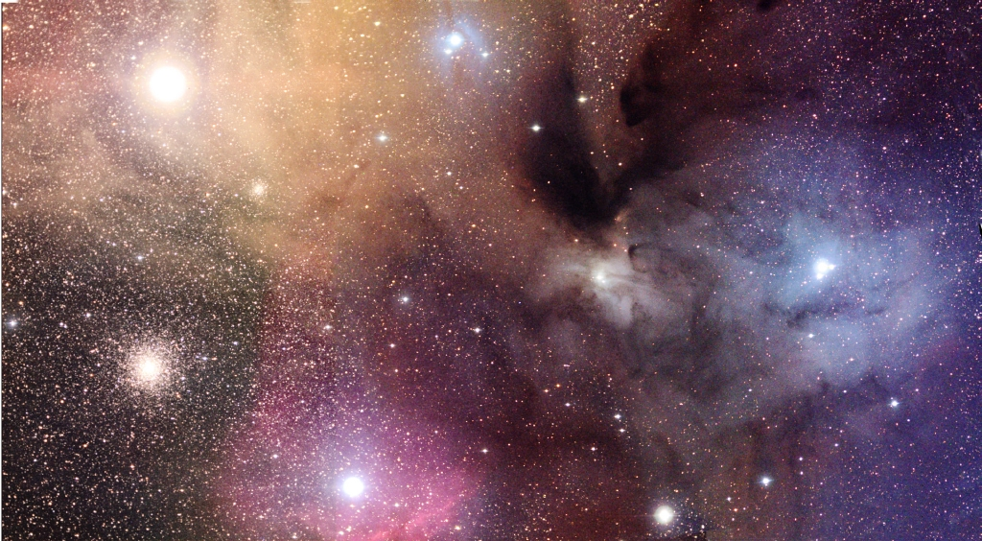
The Point(s) of it All
Gas (red, yellow, blue) and dust (dark clouds) in the ISM near Rho Ophiuchi;
Credit: NOAO

Slide 58
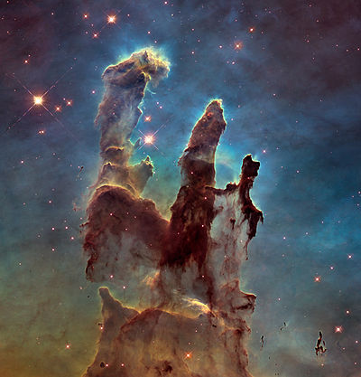
Stellar Winds Enrich Galaxies: Hot Stars
Line-driven winds expel H, He, C, N, O, Fe, and their varied stable isotopes (and other elements)
Elements in winds seed the gas and dust sitting between stars in the Milky Way (the ISM)
Enriched ISM produces new stars with higher elemental content (metallicity); allows for planet formation
Radiation pressure from winds churn local ISM, encouraging star birth
The Pillars of Creation, Eagle Nebula
Hubble Space Telescope
Notes:
Many stars in the image are hot blue stars with their blue light scattered away from the observer. The structure of the dense gas clouds shown is largely due to radiation pressure from stellar winds

Slide 59
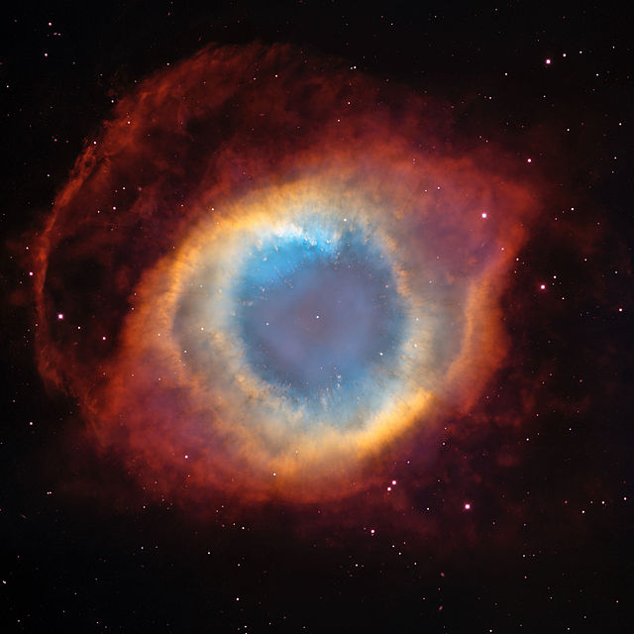
Stellar Winds Enrich Galaxies: Cool Stars
Convection mixes fusion, s-process, & α-process products to stellar surface
Dust-driven winds from AGB stars return nuclear products to ISM as dust and molecular gas
In the LMC AGB winds return 5.5-11.5 x 10⁻⁵ M⊙ yr⁻¹ in dust and another 11-23 x 10⁻³ M⊙ yr⁻¹ in gas (Matsuura et al 2009; excludes cluster stars)
NGC 7293 - The Helix Nebula
ESA, NASA
Notes:
In AGB stars convection mixes fusion, s-process elements, and alpha-process elements to the stellar surface.
Dust driven winds from AGB stars return these products of nucleosynthesis to the ISM as molecular gas and dust grains
As an example, in the LMC AGB winds in total return 5.5-11.5 x 10⁻⁵ solar masses of dust and between 11 and 23 x 10⁻³ solar masses of gas per year.

Slide 60
Stellar Winds Characterize Stellar Neighborhoods
Metallicity can serve as proxy for tracking generations of stars
Brightness (mag)
Sub-giants in ω Cen
Villanova et al 2014
Temperature
Notes:
In the table on the left from Villanova et al 2014, we see 6 different populations of subgiant stars in the globular cluster omega Cen. These different populations are divided based on their iron abundance. The ages of stars in these populations is determined by which stars have left the Main Sequence. At the upper and lower metallicity limits the stars show clear age differences. Additionally, even though there’s significant blending between populations of different metallicities, there’s a clear age progression in these subgiant stars. What’s interesting here is that from this age metallicity spread, the authors are able to conclude that likely resulted from the merging of two dwarf galaxies of signficantly different metallicities.

Slide 61
Stellar Wind Enrichment Characterizes Galaxies
Metallicity can track structure of the Galaxy
Bovy et al 2012

Slide 62
The Wrap Up
Stars of all types—low, intermediate, and high-mass—lead dynamic lives as they evolve to their final stages
The elements that make existence are manufactured in the hot bowels of stars
In their later stages, stars lose large fractions of mass due to their own pulsations and/or radiation
Powerful stellar winds return gas and dust from star surfaces and interiors into the Galaxy
Enrichment from stars seeds galaxy throughout, and allows for stellar life to begin anew

Slide 63

Relation to My Work
AGB Stars Probing
the Structure and Evolution of the Milky Way
Recall: warm O-rich and C-rich dust in dust-driven winds from AGB stars shine in the mid-IR
Even while light from AGB surface obscured, dusty shells light up in IR
Also: AGB phase is last stellar phase for low/intermediate-mass stars (very abundant stars)
If identified, can be seen nearly everywhere in Galaxy, even to far side of Galaxy

Slide 64
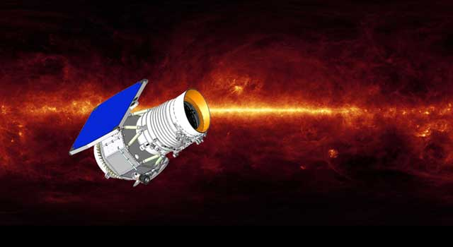
Relation to My Work
Enter: the Wide-field Infrared Survey Explorer (WISE)
Year-long survey of the full sky
Unprecedented NIR/MIR sensitivity
Catalog of 750+ million objects
Credit: http://www.jpl.nasa.gov/wise/overview.cfm

Slide 65
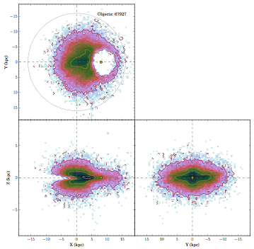
Relation to My Work
Identified ~68,000 AGB candidates in the Milky Way with WISE
Use candidates for 3D map of the Milky Way
Measurements of vertical and radial extent of the disk
Can be used to verify models of Galactic structure
Hunt-Walker et al. in prep
Y
The Sun
Z
X (kpc)
Y (kpc)

Slide 66
Relation to My Work
Matches of AGB candidates to SDSS APOGEE Red Giant Survey
Measurements of metallicity in SDSS combined with measurements from AGB candidate sample = 3D chemical/age map of the Galaxy
Galactic Latitude
Galactic Longitude (deg)
Hunt-Walker et al. in prep

Slide 67




Acknowledgments
Grad students (current and former)
Folks with Feedback
Textbooks, papers, sanity checks, general inspiration, motivation, reassurance
Dre Dunlap
Eddie Schwieterman
Cliff Johnson
Diana Windemuth
Russell Deitrick
Phil Rosenfield
Jim Davenport
Nell Byler
Phoebe Sanderbeck
Ismael Simekha
Rhoan Garnett
Alma Khasawnih
José Hernandez

Slide 68


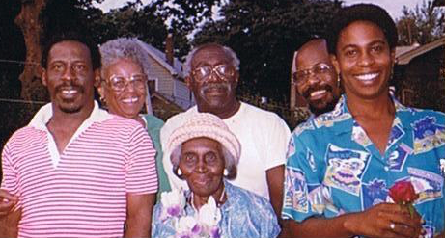

Acknowledgments
Family

Slide 69




Acknowledgments
Friends old and new

Slide 70




Acknowledgments
The Lady

Slide 71


Slide 72
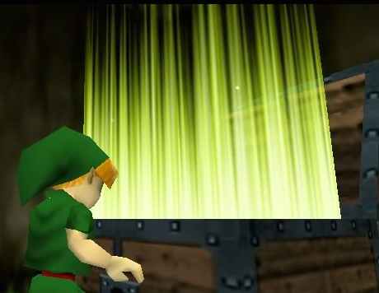
BONUS
SLIIIIIIDES

Slide 73

Conflicting views on Stellar Winds

Slide 74
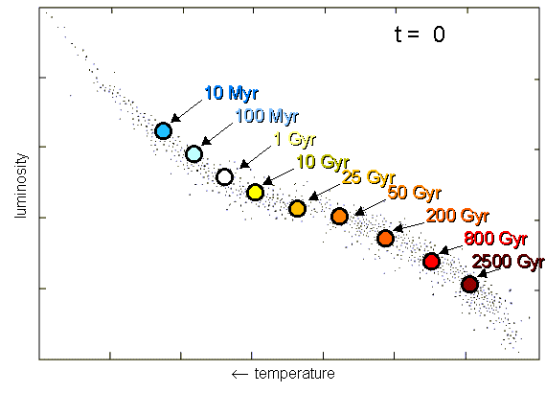
The Main Sequence
*1 Gyr = 1 billion years
Credit: http://astro.berkeley.edu/~dperley/univage/univage.html
Notes:
Massive stars live shorter lives than less massive stars, illustrated here. This is chiefly because they have more mass. More mass = more gravity. More gravity = more energy needed to stave off collapse. Higher energy production means more hydrogen consumption in the core, shortening the main sequence life span.

Slide 75
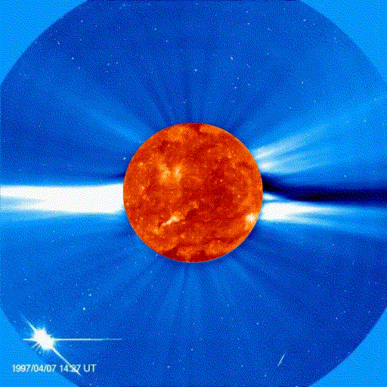
The Sun’s Coronal Wind
Note: not occurring in a late stage of evolution
Driven by gas pressure, thermal conduction in the corona, and Sun’s magnetic fields
At large distances from the Sun, hot coronal plasma can escape
Responsible for loss of 10⁻¹⁴M⊙ yr⁻¹ (very low rate); reduces Sun’s mass by 0.01% over life
Credit: http://solarscience.msfc.nasa.gov/CMEs.shtml

Slide 76
The Main Sequence
P-P Chain II (simp.)
H
H
e⁻
N
N
H
H
N
N
⁷Be
⁷Li
H
H
N
N
H
H
N
H
γ

Slide 77
The Main Sequence
P-P Chain III (simp.)
H
H
H
e⁺
N
N
H
H
N
N
⁷Be
⁸B
⁸Be
H
H
N
N
H
H
N
γ

Slide 78
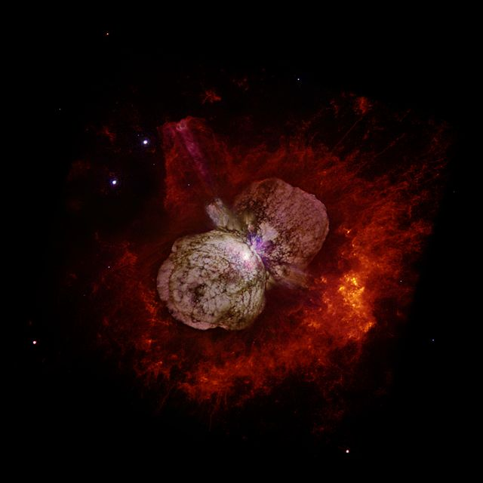
High-mass Star Evolution: LBVs
Another brief stage of life before SN explosion
“Luminous Blue Variable”
Final stage of the most massive stars
Most of radiation in UV
Extremely high mass loss (more on that later)
LBV binary Eta Carinae
Hubble Space Telescope

Slide 79
Low/Intermediate-mass Star Evolution
*A Note About Very Low-Mass Stars
M < 0.8 M⊙ fuse H on the Main Sequence but are not massive enough to fuse He
Main sequence lifetimes exceed age of galaxy and universe; no actual post-MS products have been observed

Slide 80
High-mass Star Evolution: Mass Matters
All stars with M* > 10 M⊙ end as supernovae (SNe)
If M* < 25 M⊙, life ends as red supergiant (RSG) after fusing to Fe before SN
If 25 < M* < 50 M⊙, life ends as Wolf-Rayet star (WR) before SN
If M* > 50 M⊙, they don’t make it to RSG phase; become Luminous Blue Variables during He-shell fusion, lose atmosphere, then WR to SN

Slide 81
The Main Sequence
CNO Cycle II (simplified)
H
H
⁴He
Low probability
N
N
H
H
¹⁴N
γ
¹⁷O
¹⁵O
e⁺
e⁺
¹⁷F
¹⁵N
γ
¹⁶O
H
H
γ

Slide 82
Line-driven Winds
P Cygni profiles tell-tale signs of line-driven wind
Observed regularly in hot stars of all stages of evolution
Mujires 2010
Intensity
Wavelength

Slide 83
Relation to My Work
Hunt-Walker et al. in prep
Measurements of vertical and radial extent of the disk
Verification of existing models of Milky Way disk structure

